Slide 1
Grover on ClassicMcEliece
장경배
https://youtu.be/q7Vs4nJ3q2Y

Slide 2
Remind

Slide 3
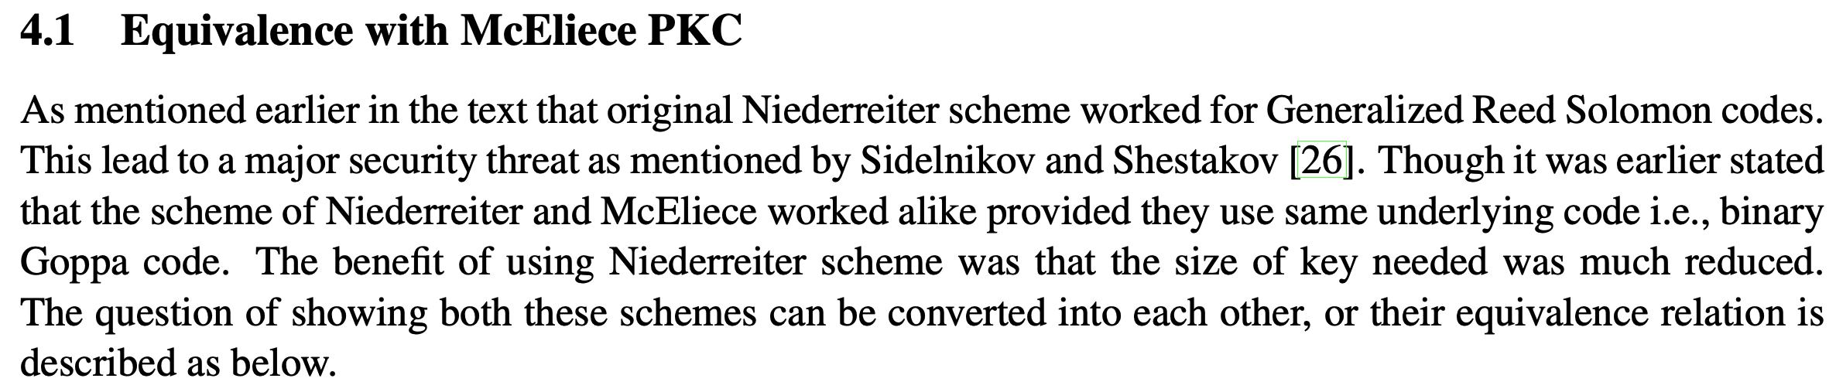
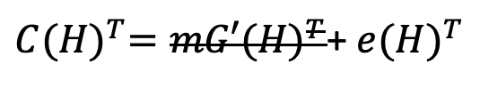


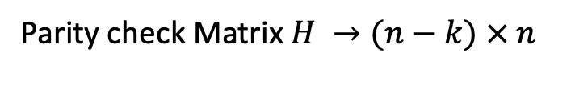
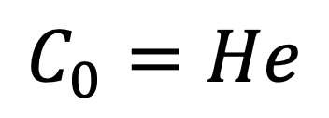

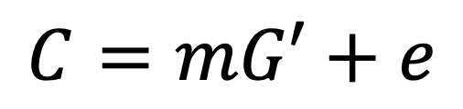

Code-based Cryptography
같은 Goppa code($G$, $H$)를 사용하는 경우
Niederreiter System의 문제를 푸는 것은 McEliece System을 푸는 것과 동일
McEliece System to Niederreiter System
$$C_{0}=He$$
$$≅$$
$$C=mG′+e$$
Parity check Matrix $H →(n−k) × n$
Generator Matrix $G^{′}→(k × n)$
$C{(H)}^{T}=mG′{(H)}^{T}$+ ${e(H)}^{T}$
$C{(H)}^{T}=$ ${e(H)}^{T}$

Slide 4





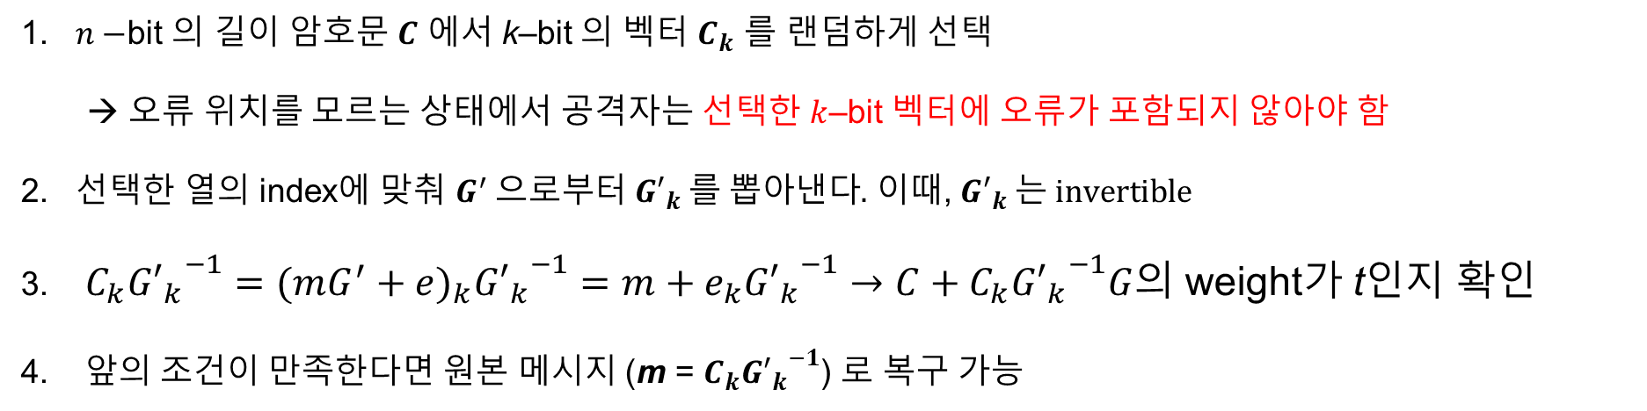







Information Set Decoding (ISD)
Prange’s ISD
1. $n−$bit 의 길이 암호문 $C$ 에서 k–bit 의 벡터 $C_{k}$ 를 랜덤하게 선택
→ 오류 위치를 모르는 상태에서 공격자는 선택한 $k$–bit 벡터에 오류가 포함되지 않아야 함
2. 선택한 열의 index에 맞춰 $G^{′} 으로부터 {G′}_{k} 를 뽑아낸다.$ 이때, ${G′}_{k} 는 invertible$
3. $C_{k}{{G′}_{k}}^{−1}={(mG^{′}+e)}_{k}{{G′}_{k}}^{−1}=m+e_{k}{{G′}_{k}}^{−1}→C+C_{k}{{G′}_{k}}^{−1}G$의 weight가 t인지 확인
4. 앞의 조건이 만족한다면 원본 메시지 (m = ${C_{k}{G′}_{k}}^{−1}$) 로 복구 가능
$$(mG+e)+mG=e$$
$$m$$
$$×$$
$$G$$
$$+$$
$$e$$
$$=$$
$$C$$
1
1
1
$$1 × 3488$$
$$1 × 3488$$
$$2720 × 3488$$
$$1 × 2720$$

Slide 5

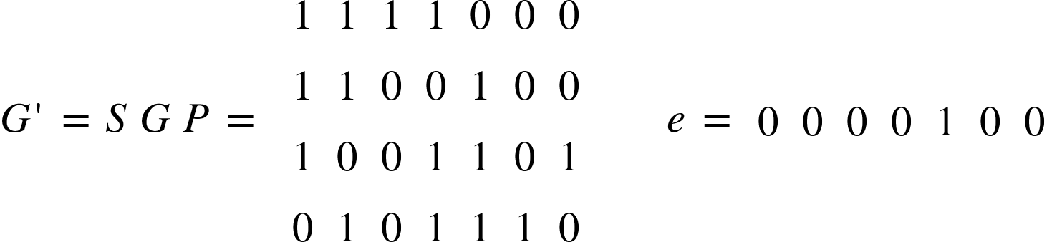


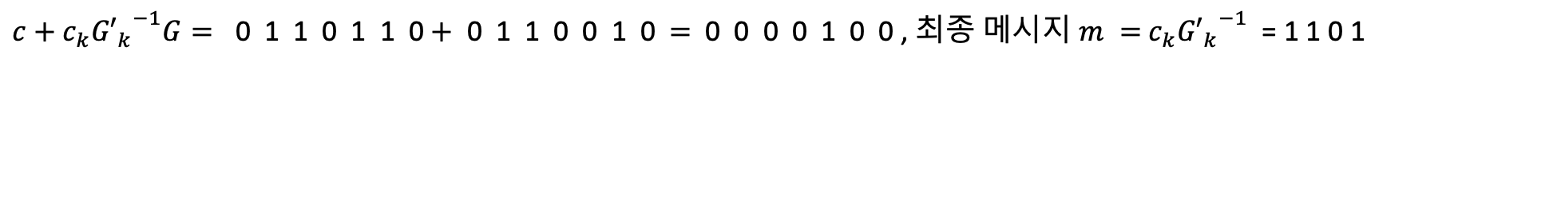



Information Set Decoding (Toy)
1. $n$–bit 의 길이 암호문 $(c$)에서 $k$–bit의 벡터 ($c_{k}$)를 무작위 선택
2. 이때, ${G′}_{k} 는 invertible$, ${{G′}_{k}}^{−1}$ 계산 $→$
Secret
1 1 1 0
1 1 0 0
1 0 0 0
0 1 0 1
$c_{k}$ = 0 1 1 1 ${G′}_{k} =$
0 0 1 0
0 1 1 0
1 1 0 0
0 1 1 1
${{G′}_{k}}^{−1}=$
3. 밑의 결과 벡터의 weight를 확인 ($t$)
$c+{c_{k}{G′}_{k}}^{−1}G=\text{ 0 1 1 0 1 1 0}+$ 0 1 1 0 0 1 0 $=$ 0 0 0 0 1 0 0 , 최종 메시지 $m =$ ${c_{k}{G′}_{k}}^{−1}$ = 1 1 0 1

Slide 6
ISD on ClassicMcEliece

Slide 7
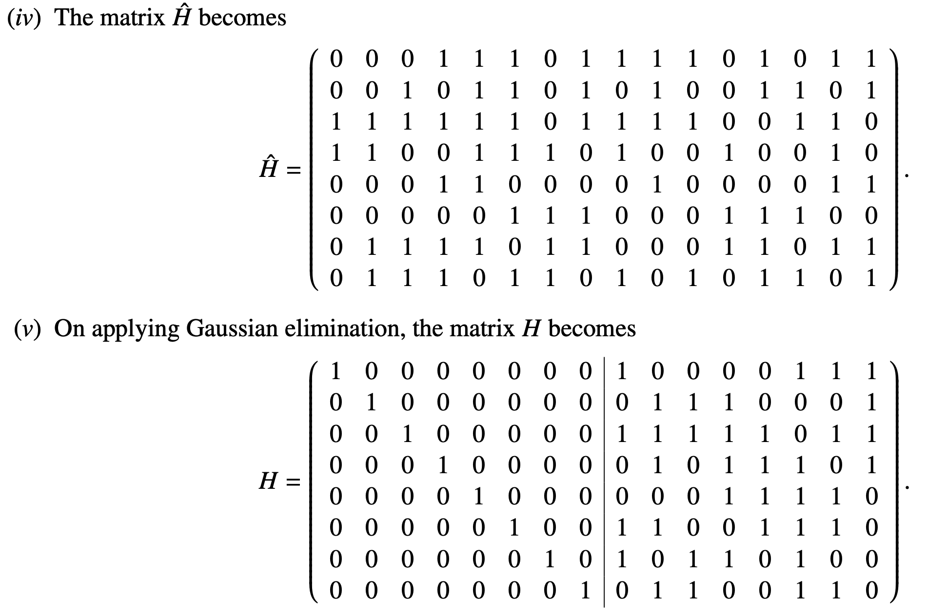

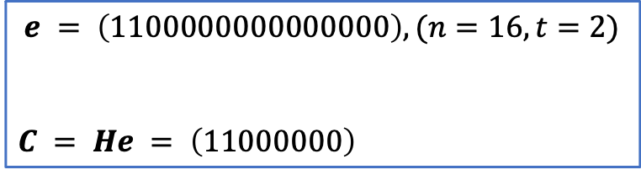
Information Set Decoding on CM
Parity check 행렬을 공개키로 사용하는 Niederreiter system의 경우 ISD 접근방식이 조금 다름
공격자가 선택한 Columns에 오류가 모두 포함되어 있어야 함
$$e = \left(1100000000000000\right), (n=16, t=2)$$
$$C = He = \left(11000000\right)$$
Secret
$(n−k) × n$ , ( 8 $×$16 )

Slide 8
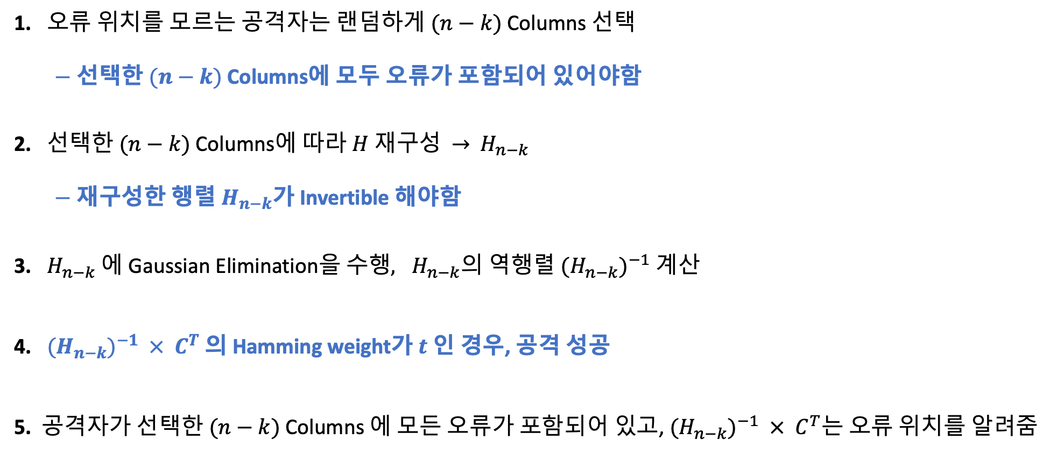
Information Set Decoding on CM
1. 오류 위치를 모르는 공격자는 랜$덤하게 (n−k)$Columns 선택
$−$ 선택한 $(n−k)$Columns에 모두 오류가 포함되어 있어야함
2. 선택한 $(n−k)$Columns에 따라 $H$ 재구성 $→$ ${ H}_{n−k}$
$−$ 재구성한 행렬 $H_{n−k}$가 Invertible 해야함
3. $H_{n−k}$에 Gaussian Elimination을 수$행, H_{n−k}의$ 역행렬 $({H_{n−k})}^{−1}$ 계산
4. ${(H_{n−k})}^{−1} × C^{T}$ 의 Hamming weight가 $t$ 인 경우, 공격 성공
5. 공격자가 선택한 $(n−k)$Columns 에 모든 오류가 포함되어 있고, ${(H_{n−k})}^{−1} × C^{T}$는 오류 위치를 알려줌

Slide 9
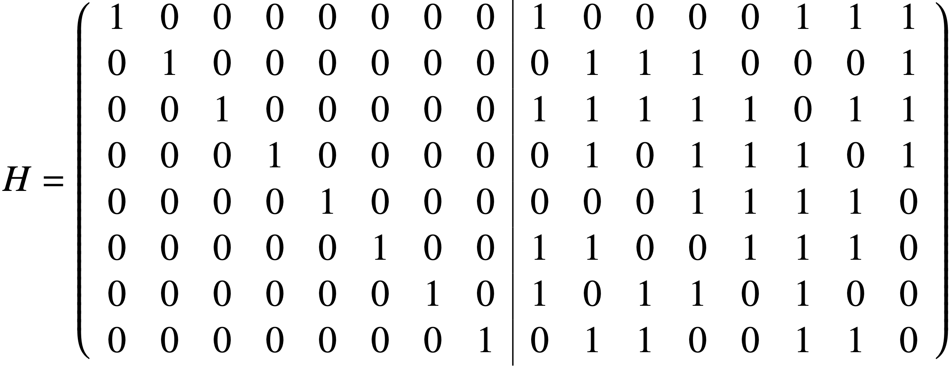
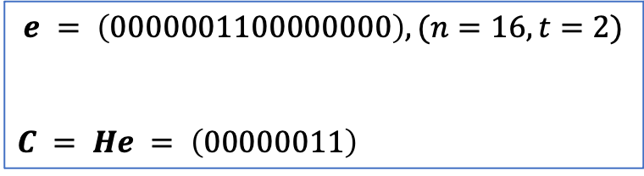

$$H_{n−k}$$
$$e = \left(0000001100000000\right), (n=16, t=2)$$
$$C = He = \left(00000011\right)$$
Secret
0 0 1 0 0 0 0 1
0 0 0 1 1 1 0 0
0 0 1 1 1 1 1 0
0 0 0 1 0 1 1 1
0 0 0 0 0 1 1 1
0 0 1 1 0 0 1 1
1 0 1 0 1 1 0 1
0 1 0 1 1 0 0 1
1 0 0 0 0 0 0 0
0 1 0 0 0 0 0 0
0 0 1 0 0 0 0 0
0 0 0 1 0 0 0 0
0 0 0 0 1 0 0 0
0 0 0 0 0 1 0 0
0 0 0 0 0 0 1 0
0 0 0 0 0 0 0 1
1 0 1 0 1 1 0 1
0 0 0 1 1 1 0 0
0 0 1 1 1 1 1 0
0 0 0 1 0 1 1 1
0 0 0 0 0 1 1 1
0 0 1 1 0 0 1 1
0 0 1 0 0 0 0 1
0 1 0 1 1 0 0 1
0 0 0 0 0 0 1 0
0 1 0 0 0 0 0 0
0 0 1 0 0 0 0 0
0 0 0 1 0 0 0 0
0 0 0 0 1 0 0 0
0 0 0 0 0 1 0 0
1 0 0 0 0 0 0 0
0 0 0 0 0 0 0 1
1 0 1 0 1 1 0 1
0 1 0 1 1 0 0 1
0 0 1 1 1 1 1 0
0 0 0 1 0 1 1 1
0 0 0 0 0 1 1 1
0 0 1 1 0 0 1 1
0 0 1 0 0 0 0 1
0 0 0 1 1 1 0 0
0 0 0 0 0 0 1 0
0 0 0 0 0 0 0 1
0 0 1 0 0 0 0 0
0 0 0 1 0 0 0 0
0 0 0 0 1 0 0 0
0 0 0 0 0 1 0 0
1 0 0 0 0 0 0 0
0 1 0 0 0 0 0 0

Slide 10
1 0 1 0 1 1 0 1
0 1 0 1 1 0 0 1
0 0 1 1 1 1 1 0
0 0 0 1 0 1 1 1
0 0 0 0 0 1 1 1
0 0 1 1 0 0 1 1
0 0 1 0 0 0 0 1
0 0 0 1 1 1 0 0
0 0 0 0 0 0 1 0
0 0 0 0 0 0 0 1
0 0 1 0 0 0 0 0
0 0 0 1 0 0 0 0
0 0 0 0 1 0 0 0
0 0 0 0 0 1 0 0
1 0 0 0 0 0 0 0
0 1 0 0 0 0 0 0
1 0 1 0 1 1 0 1
0 1 0 1 1 0 0 1
0 0 1 1 1 1 1 0
0 0 0 1 0 1 1 1
0 0 0 0 0 1 1 1
0 0 0 0 1 1 0 1
0 0 0 1 1 1 1 1
0 0 0 1 1 1 0 0
0 0 0 0 0 0 1 0
0 0 0 0 0 0 0 1
0 0 1 0 0 0 0 0
0 0 0 1 0 0 0 0
0 0 0 0 1 0 0 0
0 0 1 0 0 1 0 0
1 0 1 0 0 0 0 0
0 1 0 0 0 0 0 0
1 0 1 0 1 1 0 1
0 1 0 1 1 0 0 1
0 0 1 1 1 1 1 0
0 0 0 1 0 1 1 1
0 0 0 0 0 1 1 1
0 0 0 0 1 1 0 1
0 0 0 0 1 0 0 0
0 0 0 0 1 0 1 1
0 0 0 0 0 0 1 0
0 0 0 0 0 0 0 1
0 0 1 0 0 0 0 0
0 0 0 1 0 0 0 0
0 0 0 0 1 0 0 0
0 0 1 0 0 1 0 0
1 0 1 1 0 0 0 0
0 1 0 1 0 0 0 0
1 0 1 0 1 1 0 1
0 1 0 1 1 0 0 1
0 0 1 1 1 1 1 0
0 0 0 1 0 1 1 1
0 0 0 0 1 1 0 1
0 0 0 0 0 1 1 1
0 0 0 0 1 0 0 0
0 0 0 0 1 0 1 1
0 0 0 0 0 0 1 0
0 0 0 0 0 0 0 1
0 0 1 0 0 0 0 0
0 0 0 1 0 0 0 0
0 0 1 0 0 1 0 0
0 0 0 0 1 0 0 0
1 0 1 1 0 0 0 0
0 1 0 1 0 0 0 0
1 0 1 0 1 1 0 1
0 1 0 1 1 0 0 1
0 0 1 1 1 1 1 0
0 0 0 1 0 1 1 1
0 0 0 0 1 1 0 1
0 0 0 0 0 1 1 1
0 0 0 0 0 1 0 1
0 0 0 0 0 1 1 0
0 0 0 0 0 0 1 0
0 0 0 0 0 0 0 1
0 0 1 0 0 0 0 0
0 0 0 1 0 0 0 0
0 0 1 0 0 1 0 0
0 0 0 0 1 0 0 0
1 0 0 1 0 1 0 0
0 1 1 1 0 1 0 0
1 0 1 0 1 1 0 1
0 1 0 1 1 0 0 1
0 0 1 1 1 1 1 0
0 0 0 1 0 1 1 1
0 0 0 0 1 1 0 1
0 0 0 0 0 1 1 1
0 0 0 0 0 0 1 0
0 0 0 0 0 0 0 1
0 0 0 0 0 0 1 0
0 0 0 0 0 0 0 1
0 0 1 0 0 0 0 0
0 0 0 1 0 0 0 0
0 0 1 0 0 1 0 0
0 0 0 0 1 0 0 0
1 0 0 1 1 1 0 0
0 1 1 1 1 1 0 0

Slide 11
1 0 1 0 1 1 0 1
0 1 0 1 1 0 0 1
0 0 1 1 1 1 1 0
0 0 0 1 0 1 1 1
0 0 0 0 1 1 0 1
0 0 0 0 0 1 1 1
0 0 0 0 0 0 1 0
0 0 0 0 0 0 0 1
0 0 0 0 0 0 1 0
0 0 0 0 0 0 0 1
0 0 1 0 0 0 0 0
0 0 0 1 0 0 0 0
0 0 1 0 0 1 0 0
0 0 0 0 1 0 0 0
1 0 0 1 1 1 0 0
0 1 1 1 1 1 0 0
1 0 1 0 1 1 0 0
0 1 0 1 1 0 0 0
0 0 1 1 1 1 1 0
0 0 0 1 0 1 1 0
0 0 0 0 1 1 0 0
0 0 0 0 0 1 1 0
0 0 0 0 0 0 1 0
0 0 0 0 0 0 0 1
0 1 1 1 1 1 1 0
0 1 1 1 1 1 0 1
0 0 1 0 0 0 0 0
0 1 1 0 1 1 0 0
0 1 0 1 1 0 0 0
0 1 1 1 0 1 0 0
1 0 0 1 1 1 0 0
0 1 1 1 1 1 0 0
1 0 1 0 1 1 0 0
0 1 0 1 1 0 0 0
0 0 1 1 1 1 0 0
0 0 0 1 0 1 0 0
0 0 0 0 1 1 0 0
0 0 0 0 0 1 0 0
0 0 0 0 0 0 1 0
0 0 0 0 0 0 0 1
0 1 1 1 1 1 1 0
0 1 1 1 1 1 0 1
1 0 1 1 1 1 0 0
1 1 1 1 0 0 0 0
0 1 0 1 1 0 0 0
1 1 1 0 1 0 0 0
1 0 0 1 1 1 0 0
0 1 1 1 1 1 0 0
1 0 1 0 1 0 0 0
0 1 0 1 1 0 0 0
0 0 1 1 1 0 0 0
0 0 0 1 0 0 0 0
0 0 0 0 1 0 0 0
0 0 0 0 0 1 0 0
0 0 0 0 0 0 1 0
0 0 0 0 0 0 0 1
1 0 0 1 0 1 1 0
0 1 1 1 1 1 0 1
0 1 0 1 0 1 0 0
0 0 0 1 1 0 0 0
1 0 1 1 0 0 0 0
1 1 1 0 1 0 0 0
1 0 0 1 1 1 0 0
0 1 1 1 1 1 0 0
1 0 1 0 0 0 0 0
0 1 0 1 0 0 0 0
0 0 1 1 0 0 0 0
0 0 0 1 0 0 0 0
0 0 0 0 1 0 0 0
0 0 0 0 0 1 0 0
0 0 0 0 0 0 1 0
0 0 0 0 0 0 0 1
0 0 1 0 0 1 1 0
1 1 0 0 1 1 0 1
1 1 1 0 0 1 0 0
0 0 0 1 1 0 0 0
1 0 1 1 0 0 0 0
1 1 1 0 1 0 0 0
1 0 0 1 1 1 0 0
0 1 1 1 1 1 0 0
1 0 1 0 0 0 0 0
0 1 0 0 0 0 0 0
0 0 1 0 0 0 0 0
0 0 0 1 0 0 0 0
0 0 0 0 1 0 0 0
0 0 0 0 0 1 0 0
0 0 0 0 0 0 1 0
0 0 0 0 0 0 0 1
0 0 1 0 0 1 1 0
1 1 0 1 0 1 0 1
1 1 1 1 1 1 0 0
0 0 0 1 1 0 0 0
1 0 1 1 0 0 0 0
1 1 1 0 1 0 0 0
1 0 0 1 1 1 0 0
0 1 1 1 1 1 0 0

Slide 12
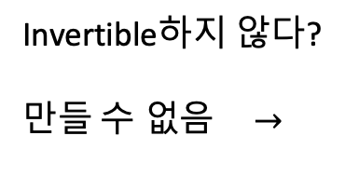

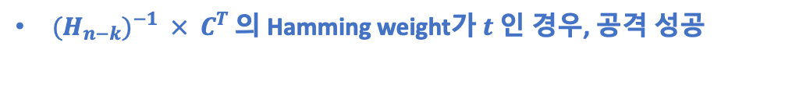




1 0 0 0 0 0 0 0
0 1 0 0 0 0 0 0
0 0 1 0 0 0 0 0
0 0 0 1 0 0 0 0
0 0 0 0 1 0 0 0
0 0 0 0 0 1 0 0
0 0 0 0 0 0 1 0
0 0 0 0 0 0 0 1
1 1 0 1 1 0 1 0
1 1 0 1 0 1 0 1
1 1 1 1 1 1 0 0
0 0 0 1 1 0 0 0
1 0 1 1 0 0 0 0
1 1 1 0 1 0 0 0
1 0 0 1 1 1 0 0
0 1 1 1 1 1 0 0
1 1 0 1 1 0 1 0
1 1 0 1 0 1 0 1
1 1 1 1 1 1 0 0
0 0 0 1 1 0 0 0
1 0 1 1 0 0 0 0
1 1 1 0 1 0 0 0
1 0 0 1 1 1 0 0
0 1 1 1 1 1 0 0
1
0 1
0 0 1
0 0 0 1
0 0 0 0 1
0 0 0 0 0 1
0 0 0 0 0 0 1
0 0 0 0 0 0 0 1
Invertible하지 않다?
만$들 수 없음$ $→$
$$({H_{n−k})}^{−1}=$$
${(H_{n−k})}^{−1} × C^{T}$ 의 Hamming weight가 $t$ 인 경우, 공격 성공
1 1 0 1 1 0 1 0
1 1 0 1 0 1 0 1
1 1 1 1 1 1 0 0
0 0 0 1 1 0 0 0
1 0 1 1 0 0 0 0
1 1 1 0 1 0 0 0
1 0 0 1 1 1 0 0
0 1 1 1 1 1 0 0
0
0
0
0
0
0
1
1
1
1
0
0
0
0
0
0
$$×$$
$$=$$
$→$ Weight = 2$(t)$
$$({H_{n−k})}^{−1} { C}^{T}$$

Slide 13

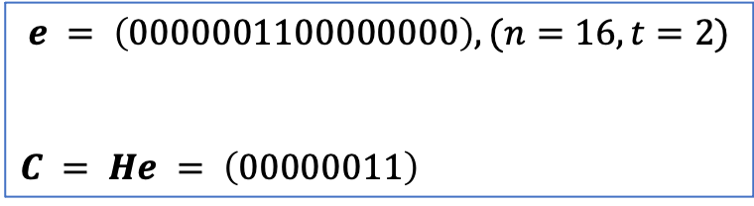




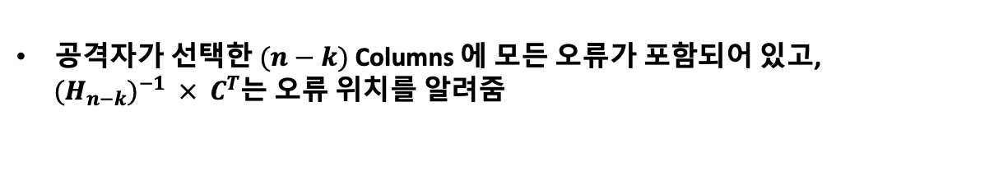
1 1 0 1 1 0 1 0
1 1 0 1 0 1 0 1
1 1 1 1 1 1 0 0
0 0 0 1 1 0 0 0
1 0 1 1 0 0 0 0
1 1 1 0 1 0 0 0
1 0 0 1 1 1 0 0
0 1 1 1 1 1 0 0
0
0
0
0
0
0
1
1
1
1
0
0
0
0
0
0
공격자가 선택한 $(n−k)$Columns 에 모든 오류가 포함되어 있고,
${(H_{n−k})}^{−1} × C^{T}$는 오류 위치를 알려줌
$$×$$
$$=$$
$$({H_{n−k})}^{−1} { C}^{T}$$
Weight = 2$(t)$
선택한 Columns의 1, 2번째에 bit가 1, 나머지가 모두 0인 벡터가 Secret
0 0 0 0 0 0
1 1 0 0 0 0 0 0
0 0
$$e = \left(0000001100000000\right), (n=16, t=2)$$
$$C = He = \left(00000011\right)$$
Secret
$$H_{n−k}$$

Slide 14

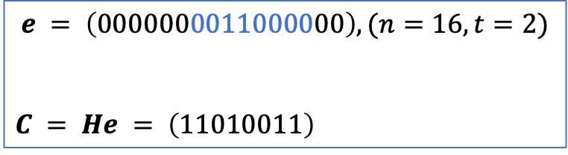






$$e = \left(0000000011000000\right), (n=16, t=2)$$
$$C = He = \left(11010011\right)$$
Secret
$$H_{n−k}$$
1 1 0 1 1 0 1 0
1 1 0 1 0 1 0 1
1 1 1 1 1 1 0 0
0 0 0 1 1 0 0 0
1 0 1 1 0 0 0 0
1 1 1 0 1 0 0 0
1 0 0 1 1 1 0 0
0 1 1 1 1 1 0 0
1
1
0
1
0
0
1
1
0
0
1
1
0
0
0
0
$$×$$
$$=$$
$$({H_{n−k})}^{−1} { C}^{T}$$
Weight = 2$(t)$
$$→$$
$$\left(0000000011000000\right)$$
선택한 Columns의 2, 3번째에 bit가 1, 나머지가 모두 0인 벡터가 Secret

Slide 15
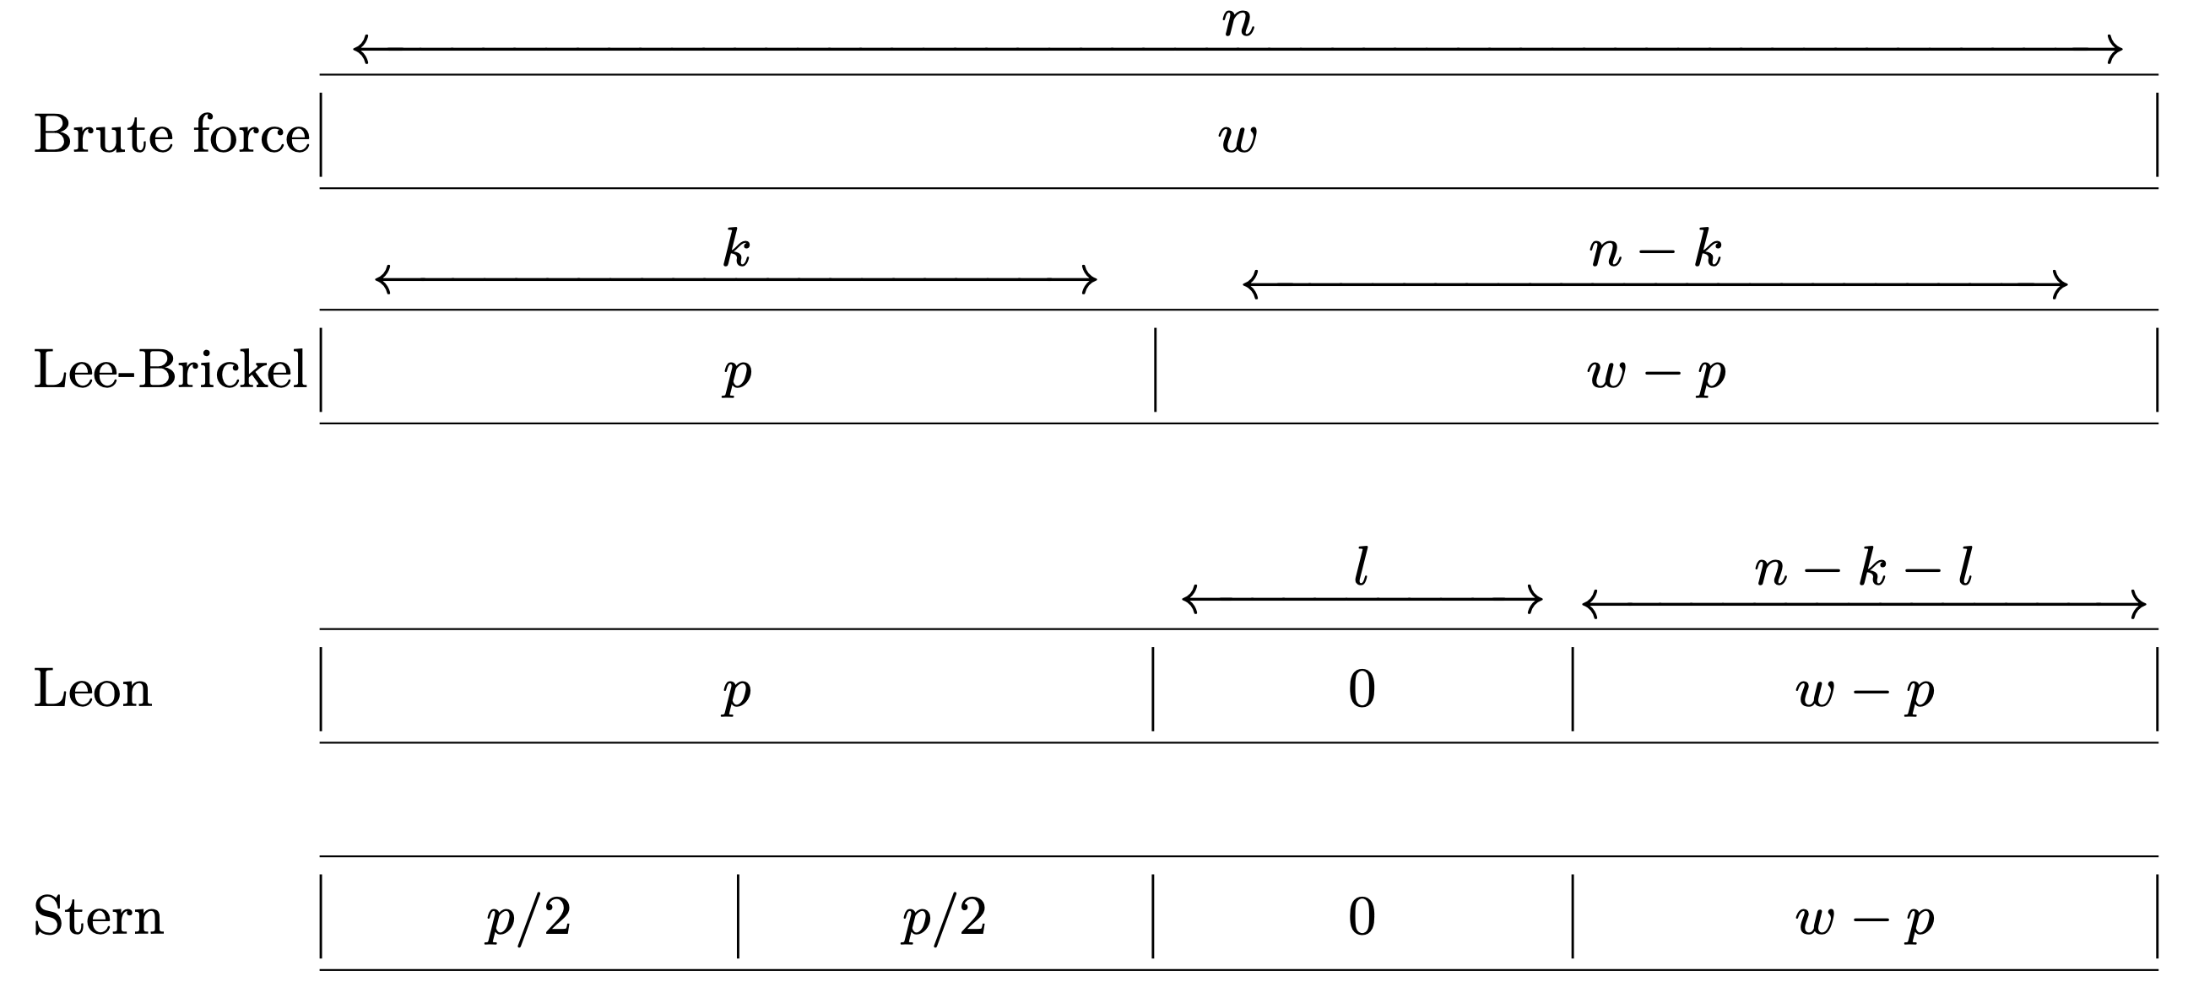

Information Set Decoding (ISD) Variants
Prange ISD는 $k$에서 $p=0$인 경우에 해당

Slide 16
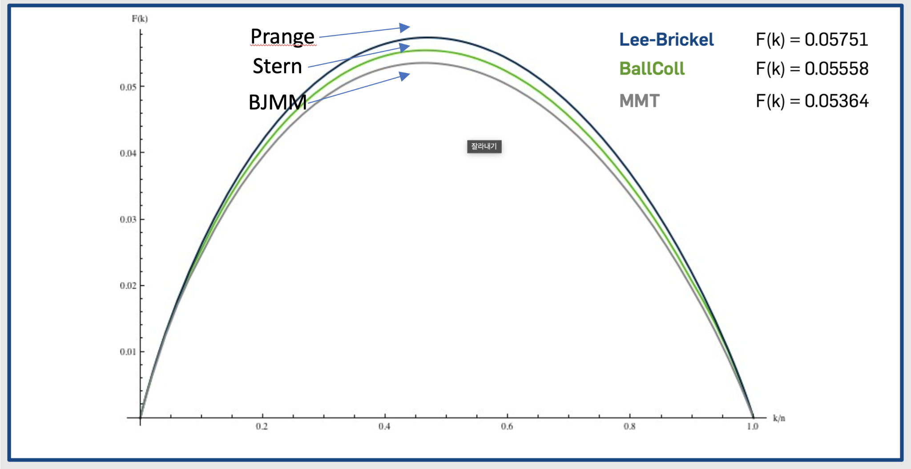
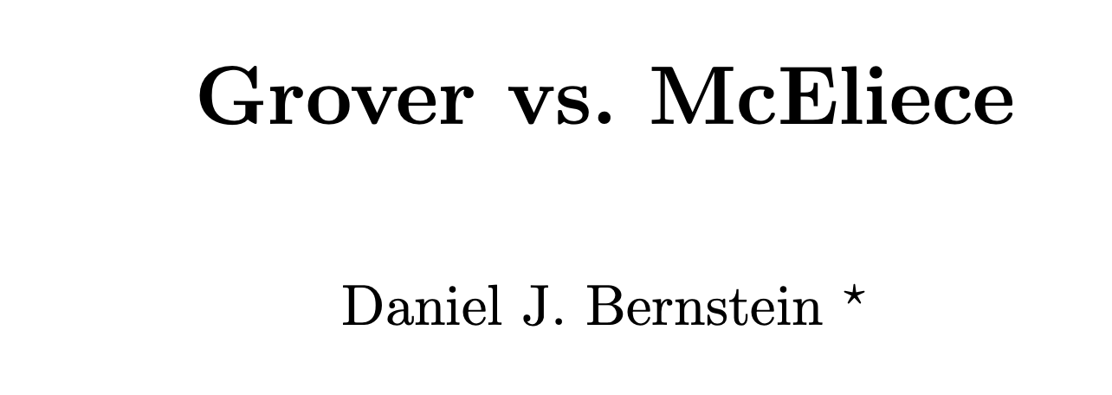
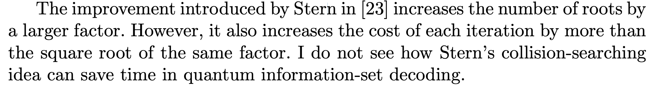
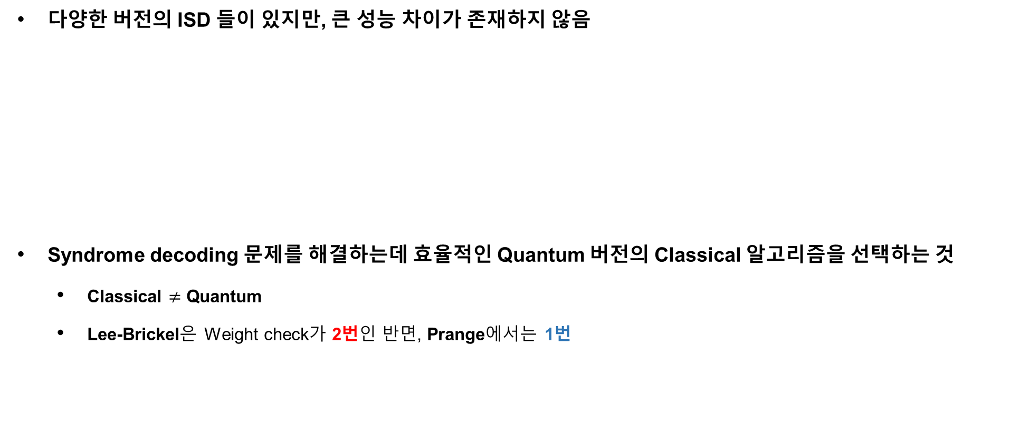
Information Set Decoding (ISD) Variants
다양한 버전의 ISD 들이 있지만, 큰 성능 차이가 존재하지 않음
Syndrome decoding 문제를 해결하는데 효율적인 Quantum 버전의 Classical 알고리즘을 선택하는 것
Classical $≠$ Quantum
Lee-Brickel은 Weight check가 2번인 반면, Prange에서는 1번

Slide 17
Grover on ClassicMcEliece

Slide 18
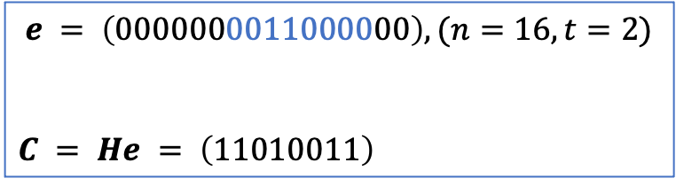

Grover on ClassicMcEliece
제일 먼저 필요한 것은 중첩 상태의 Input
공개키 $H$에서 $(n−k)$ Columns을 선택하는 모든 경우의 수를 가지고 있는
중첩 상태의 $ψ{(H}_{(n−k)})$를 구성할 수 있어야 함
$ψ{(H}_{(n−k)})$이 준비된다면, ISD 알고리즘의 수식을 양자 회로로 구현하여 적용 만 하면 됨
$$e = \left(0000000011000000\right), (n=16, t=2)$$
$$C = He = \left(11010011\right)$$
Secret

Slide 19
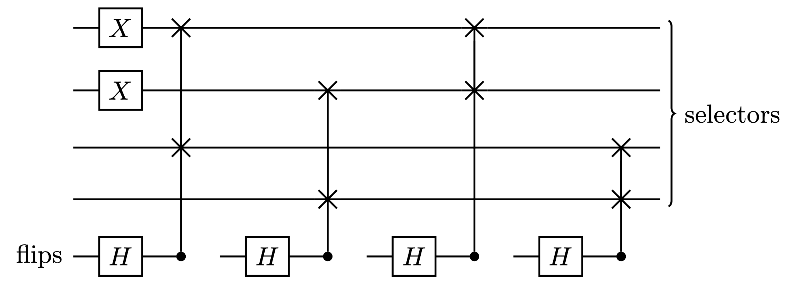

Quantum Brute Force on CM (Butterfly Network)
Butterfly Network (BN)을 활용한 $n$-bit Vector 설정 (Input)
동일한 amplitude를 위해 CSwap당 하나의 큐비트(flips) 할당
Weight
4-bit Vector (Weight = 2)

Slide 20
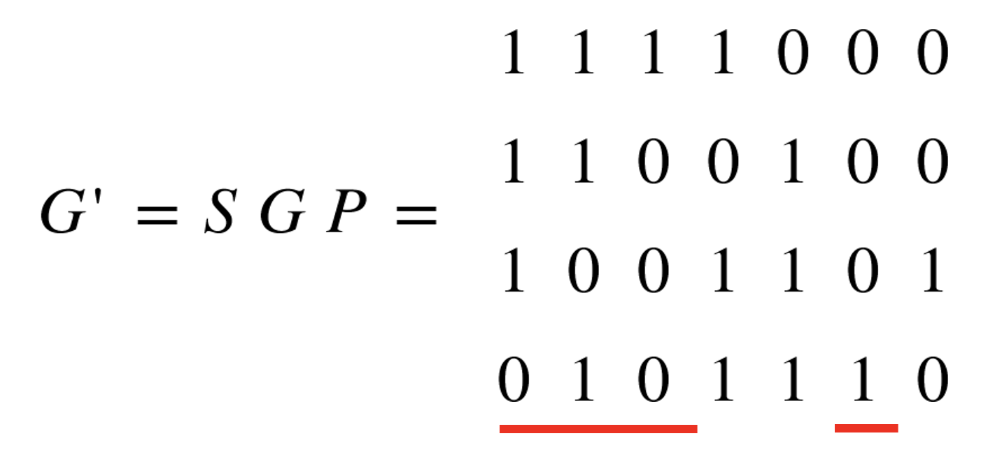










Grover on ClassicMcEliece
$n$-bit Vector에 따른 Permutation Matrix 생성
BN-network를 활용한 중첩 (7-bit, weight = 4)
$n$-bit Vector ( Weight = $k$) $→$
1 1 1 0 0 1 0
0 0 0 0 0 0 0
0 0 0 0 0 0 0
0 0 0 0 0 0 0
1 0 0 0 0 0 0
0 1 1 0 0 1 0
0 0 0 0 0 0 0
0 0 0 0 0 0 0
1 0 0 0 0 0 0
0 1 0 0 0 0 0
0 0 1 0 0 1 0
0 0 0 0 0 0 0
1 0 0 0 0 0 0
0 1 0 0 0 0 0
0 0 1 0 0 0 0
0 0 0 0 0 1 0
$$→$$
$$→$$
$$→$$
$$k × n$$
전치하여 사용
한 Column 씩 검사,
CSwap 사용 (Row 단위)
$$T$$
1 0 0 0 0 0 0
0 1 0 0 0 0 0
0 0 1 0 0 0 0
0 0 0 0 0 1 0
1 1 1 0
1 1 0 0
1 0 0 0
0 1 0 1
$$H=$$
$$×$$
$$=$$
$$H_{(n−k)}$$

Slide 21
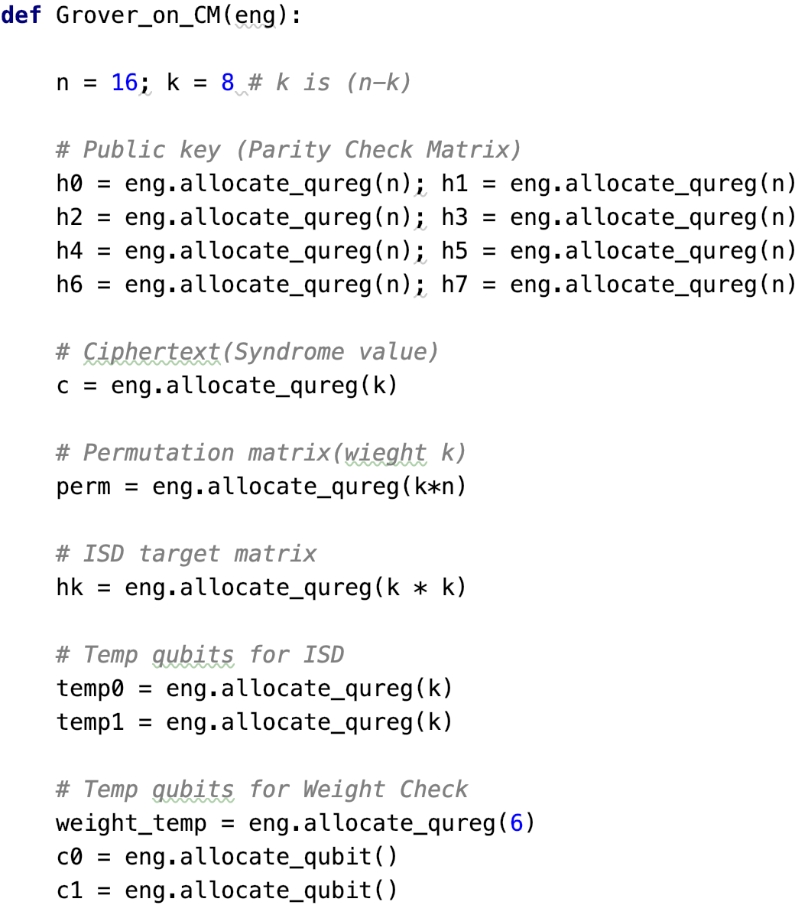


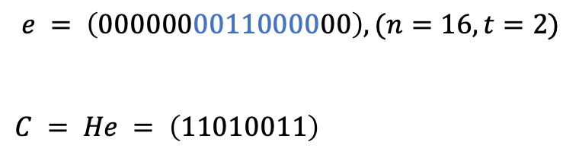
$$H_{k}$$
$$e = \left(0000000011000000\right), (n=16, t=2)$$
$$C = He = \left(11010011\right)$$
Secret
BN target
(Superposition)
0 0 0 0 0 0 0 0 0 0 0 0 0 0 0 0
0 0 0 0 0 0 0 0 0 0 0 0 0 0 0 0
0 0 0 0 0 0 0 0 0 0 0 0 0 0 0 0
0 0 0 0 0 0 0 0 0 0 0 0 0 0 0 0
0 0 0 0 0 0 0 0 0 0 0 0 0 0 0 0
0 0 0 0 0 0 0 0 0 0 0 0 0 0 0 0
0 0 0 0 0 0 0 0 0 0 0 0 0 0 0 0
0 0 0 0 0 0 0 0 0 0 0 0 0 0 0 0
Perm $=$

Slide 22
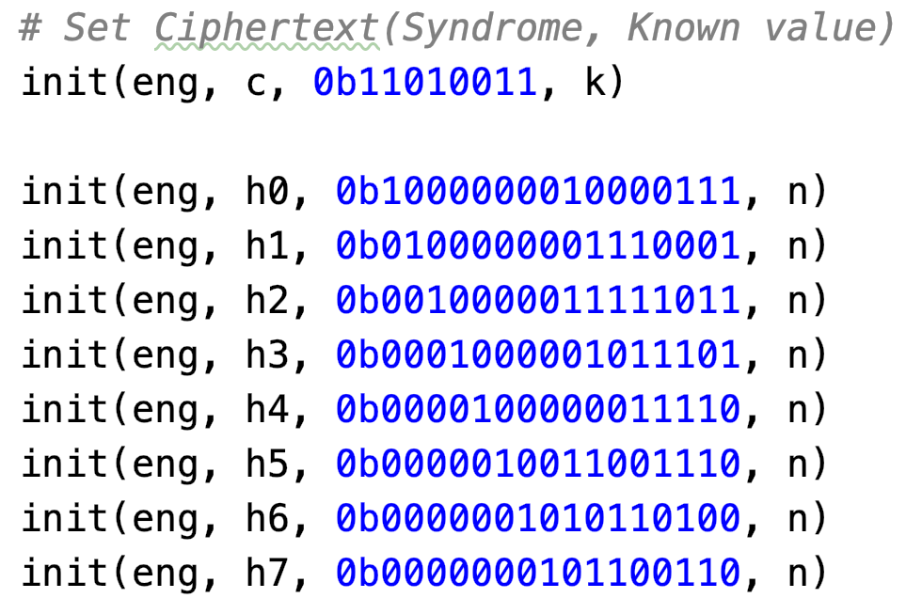
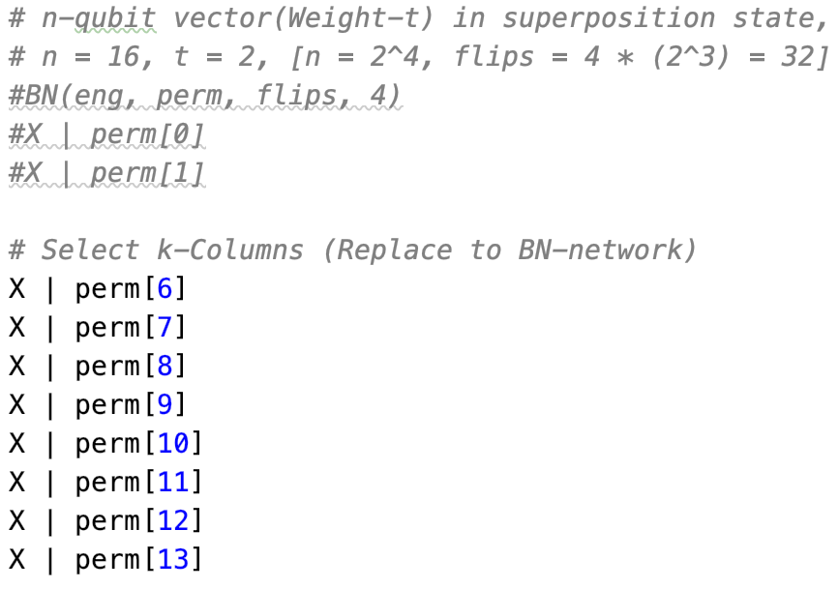
$$C = He = \left(11010011\right)$$
큐비트 제한

Slide 23
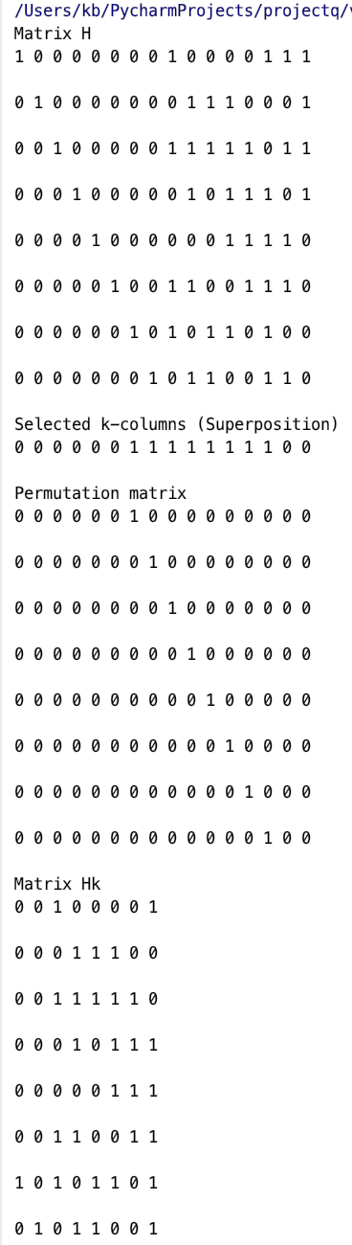
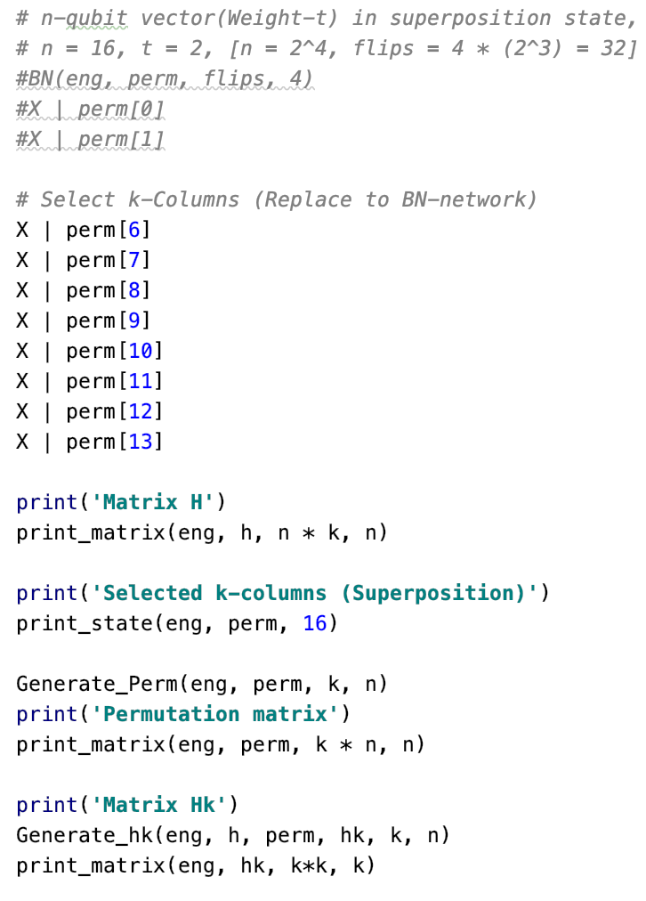


$$H$$
BN target
(Superposition)
Permutation
Matrix
$$H_{k}=(H × {Perm}^{T})$$

Slide 24
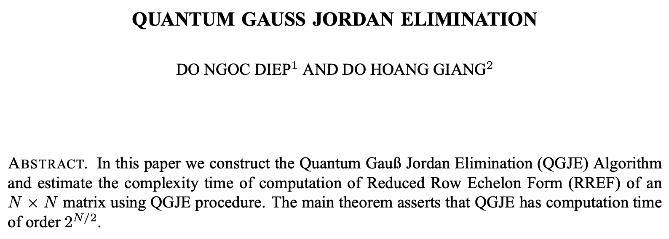
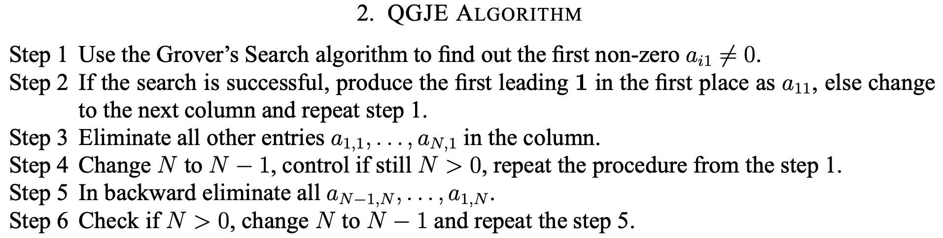
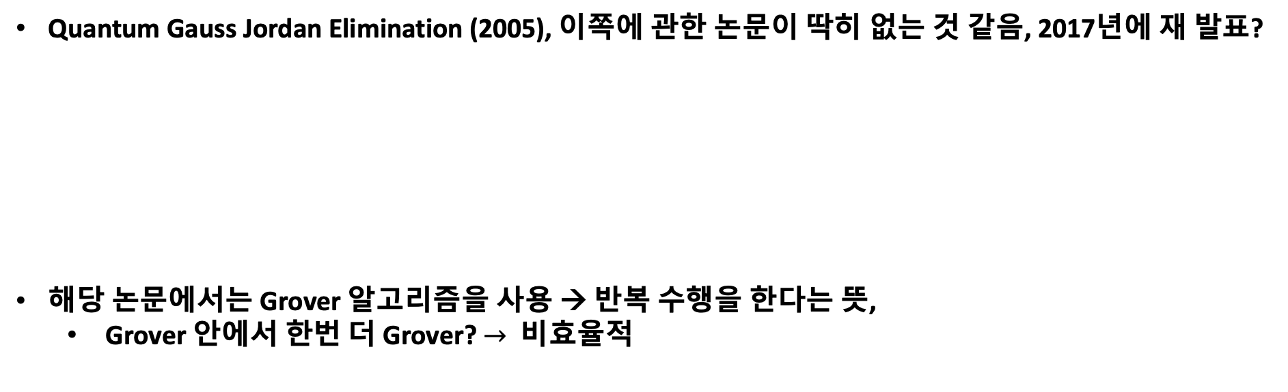
Grover on ClassicMcEliece
Quantum Gauss Jordan Elimination (2005), 이쪽에 관한 논문이 딱히 없는 것 같음, 2017년에 재 발표?
해당 논문에서는 Grover 알고리즘을 사용 → 반복 수행을 한다는 뜻,
Grover 안에서 한번 더 Grover? $→$ 비효율적

Slide 25
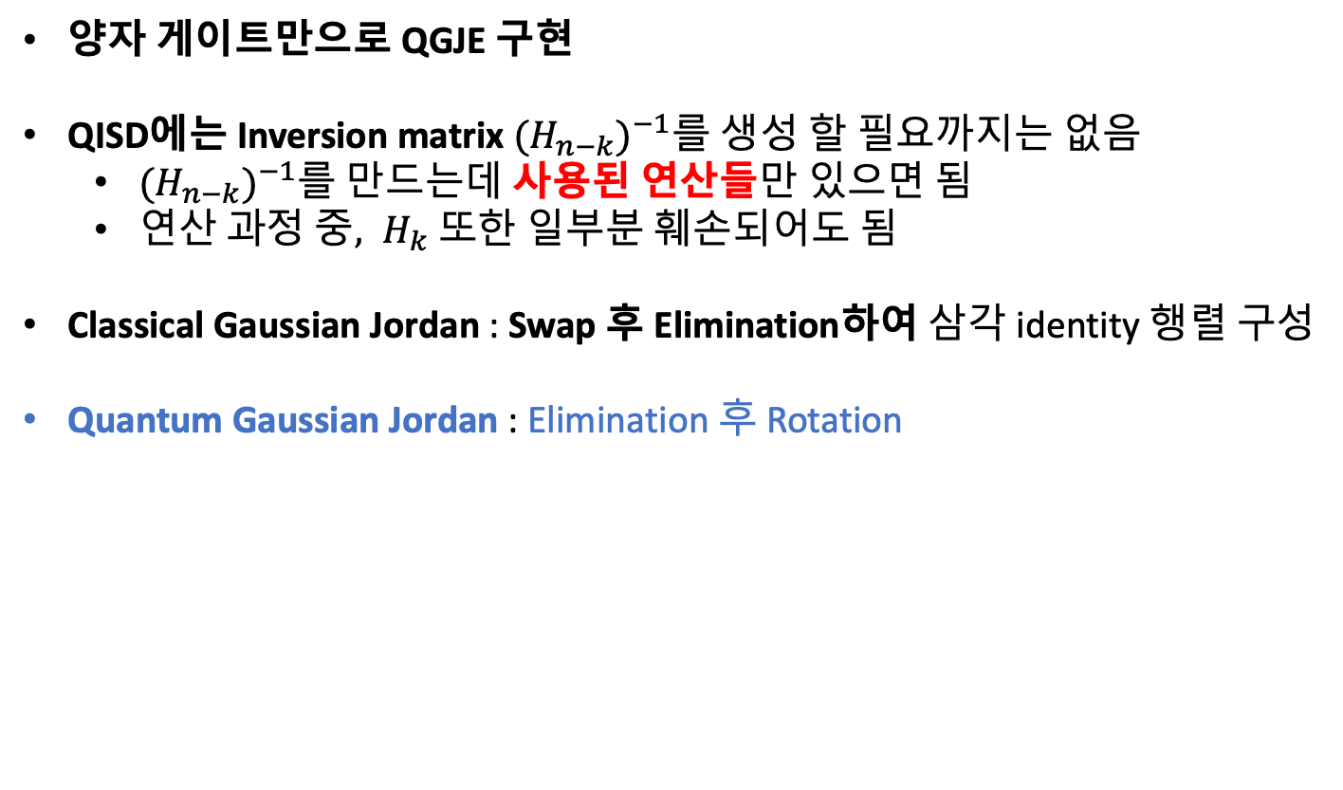
Grover on ClassicMcEliece
양자 게이트만으로 QGJE 구현
QISD에는 Inversion matrix $({H_{n−k})}^{−1}$를 생성 할 필요까지는 없음
$({H_{n−k})}^{−1}$를 만드는데 사용된 연산들만 있으면 됨
연$산 과정 중, H_{k}$ 또한 일부분 훼손되어도 됨
Classical Gaussian Jordan : Swap 후 Elimination하여 삼각 identity 행렬 구성
Quantum Gaussian Jordan : Elimination 후 Rotation

Slide 26


Temp
$$C$$
Temp
$$C$$
0
0
0
0
0
0
1
0
0
0
0
0
0
0
1
0
1
1
1
1
1
1
0
1
1
1
0
1
0
0
1
1
0 0 1 0 0 0 0 1
0 0 0 1 1 1 0 0
0 0 1 1 1 1 1 0
0 0 0 1 0 1 1 1
0 0 0 0 0 1 1 1
0 0 1 1 0 0 1 1
1 0 1 0 1 1 0 1
0 1 0 1 1 0 0 1
0 0 1 0 0 0 0 1
0 0 0 1 1 1 0 0
0 0 1 1 1 1 1 0
0 0 0 1 0 1 1 1
0 0 0 0 0 1 1 1
0 0 1 1 0 0 1 1
1 0 1 0 1 1 0 1
0 1 0 1 1 0 0 1
→
All(X) 후, CSwap 반복으로 1이 최상위로 올 때 까지 Rotation, $C$에도 같이 수행
Temp 역할 변경
Temp
$$C$$
Temp
$$C$$
1
1
1
1
1
1
0
1
1
1
1
1
0
1
0
0
1
1
1
1
1
1
0
1
1
1
1
1
0
1
0
0
1 0 1 0 1 1 0 1
0 1 0 1 1 0 0 1
0 0 1 0 0 0 0 1
0 0 0 1 1 1 0 0
0 0 1 1 1 1 1 0
0 0 0 1 0 1 1 1
0 0 0 0 0 1 1 1
0 0 1 1 0 0 1 1
1 0 1 0 1 1 0 1
0 1 0 1 1 0 0 1
0 0 1 0 0 0 0 1
0 0 0 1 1 1 0 0
0 0 1 1 1 1 1 0
0 0 0 1 0 1 1 1
0 0 0 0 0 1 1 1
0 0 1 1 0 0 1 1
→

Slide 27


Temp
$$C$$
Temp
$$C$$
1
1
1
1
0
1
0
0
1 0 1 0 1 1 0 1
0 1 0 1 1 0 0 1
1 0 1 0 0 0 0 1
1 0 0 1 1 1 0 0
1 0 1 1 1 1 1 0
1 0 0 1 0 1 1 1
1 0 0 0 0 1 1 1
1 0 1 1 0 0 1 1
1 0 1 0 1 1 0 1
1 1 0 1 1 0 0 1
0 0 1 0 0 0 0 1
0 0 0 1 1 1 0 0
0 0 1 1 1 1 1 0
0 0 0 1 0 1 1 1
0 0 0 0 0 1 1 1
0 0 1 1 0 0 1 1
1
1
1
1
0
1
0
0
Temp
$$C$$
Temp
$$C$$
1
1
1
1
0
1
0
0
1
1
1
1
0
1
0
0
0 0 1 0 1 1 0 1
1 1 0 1 1 0 0 1
0 0 1 0 0 0 0 1
0 0 0 1 1 1 0 0
0 0 1 1 1 1 1 0
0 0 0 1 0 1 1 1
0 0 0 0 0 1 1 1
0 0 1 1 0 0 1 1
0 0 1 0 1 1 0 1
1 1 0 1 1 0 0 1
1 0 1 0 0 0 0 1
0 0 0 1 1 1 0 0
1 0 1 1 1 1 1 0
0 0 0 1 0 1 1 1
0 0 0 0 0 1 1 1
1 0 1 1 0 0 1 1
.
.
.

Slide 28
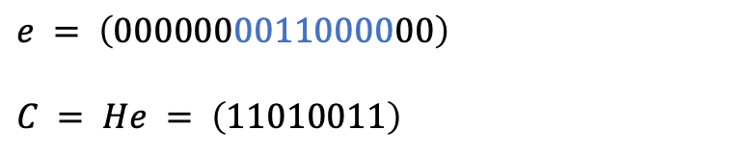



Temp
$$C$$
Temp
$$C$$
1
1
1
1
1
1
0
1
0 1 0 1 1 0 1
1 0 1 1 0 0 1
0 1 0 0 0 0 1
1 0 1 1 1 0 0
0 0 1 1 1 1 1
1 0 1 0 1 1 1
1 0 0 0 1 1 1
0 0 1 0 0 1 0
1
1
1
1
1
1
0
1
0 1 0 1 1 0 1
1 0 1 1 0 0 1
0 1 0 0 0 0 1
0 0 1 1 1 0 0
0 0 1 1 1 1 1
0 0 1 0 1 1 1
0 0 0 0 1 1 1
0 0 1 0 0 1 0
…
$$←$$
오른쪽에서 왼쪽은 Rotation 필요 없음
Elimination만 수행
Temp 큐비트 한번 더 할당
마지막으로 Weight check
Temp
$$C$$
최$종 C$
1 1 0 1 0 1 1 0 1 1
0 1 1 0 1 1 0 0 1 1
0 0 1 1 0 0 0 0 1 1
1 0 0 1 1 1 1 0 0 1
0 0 1 1 0 1 0 1 1 0
1 0 0 1 1 1 1 1 1 0
1 0 0 0 0 1 1 1 0 0
1 0 1 1 1 0 1 0 1 0
1 0 0 1 0 1 1 0 0
1 1 1 0 1 1 0 0 0
0 1 1 1 0 0 0 0 1
0 0 1 1 1 1 1 0 1
0 1 1 0 1 1 0 1 0
0 0 1 1 1 1 1 1 0
0 0 0 0 1 1 1 1 0
0 1 1 1 0 1 0 1 0
…
Secret
$$e = \left(0000000011000000\right)$$
$$C = He = \left(11010011\right)$$

Slide 29
Information Set Decoding (ISD) Variants
Prange ISD는 $k$에서 $p=0$인 경우에 해당

Slide 30
실 행 결 과

Slide 31
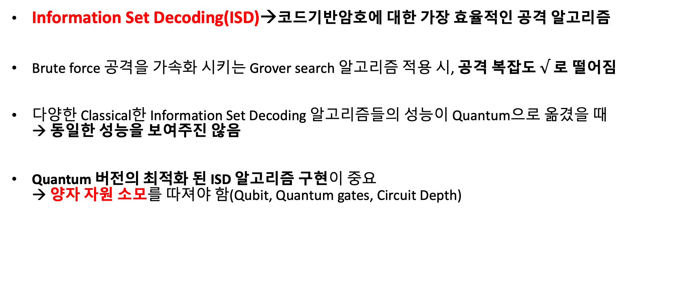
Conclusion
Information Set Decoding(ISD)→코드기반암호에 대한 가장 효율적인 공격 알고리즘
Brute force 공격을 가속화 시키는 Grover search 알고리즘 적용 시, 공격 복잡도 $√$ 로 떨어짐
다양한 Classical한 Information Set Decoding 알고리즘들의 성능이 Quantum으로 옮겼을 때 → 동일한 성능을 보여주진 않음
Quantum 버전의 최적화 된 ISD 알고리즘 구현이 중요 → 양자 자원 소모를 따져야 함(Qubit, Quantum gates, Circuit Depth)

Slide 32
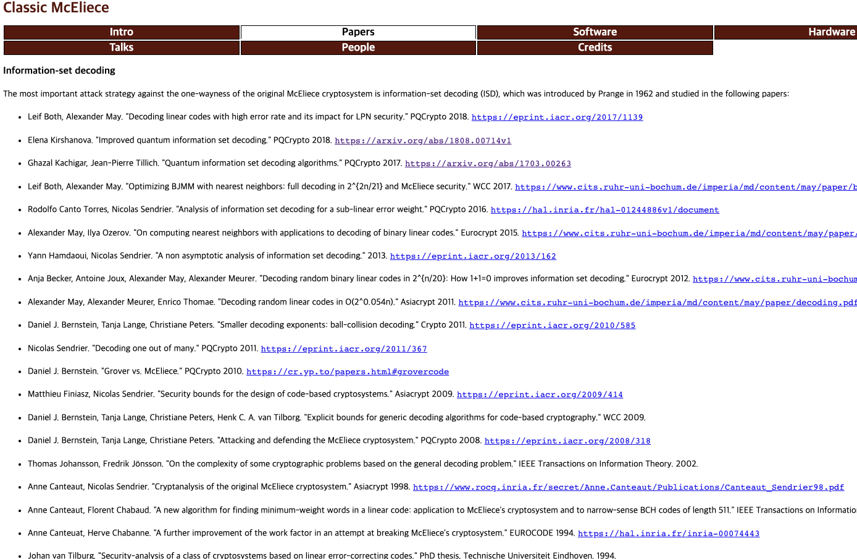
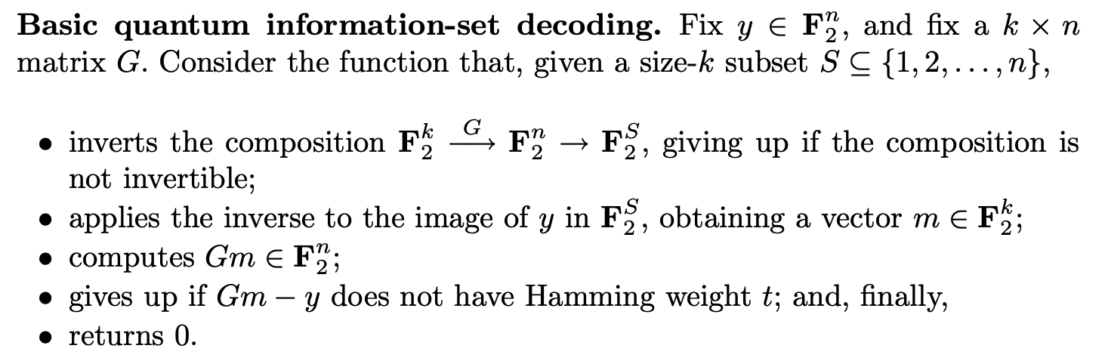
Conclusion
QISD 연구 동향

Slide 33
Conclusion
실제 Goppa 코드를 사용하는 Classic McEliece에 대한 Quantum Information Set Decoding를 구현 (8x16)
실제 CM 파라미터에 대한 자원 분석
mceliece348864 → (768 X 3488)
코드는 파라미터만 바꾸면 동작해서 큰 문제는 X
BN-network 부분 최적화 및 Grover iteration 수 고려 필요

